Slide 1
15CSE202 Object Oriented Programming
Lecture 3
Overview of Java
Nalinadevi Kadiresan
CSE Dept.
Amrita School of Engg.

Slide 2
About Java
A programming language.
  As defined by Gosling, Joy, and Steele in the Java Language Specification
A platform
  A virtual machine (JVM) definition.
  Runtime environments in diverse hardware.
A class library
  Standard APIs for GUI, data storage, processing, I/O, and networking.
June 2019
Nalinadevi Kadiresan

Slide 3
Java notes for C++ programmers
Netprog 2002 Java Intro
Everything is an object.
  Every object inherits from java.lang.Object
No code outside of class definition!
  No global variables.
Single inheritance
  an additional kind of inheritance: interfaces
All classes are defined in .java files
  one top level public class per file

Slide 4
First Program
public class HelloWorld
{
public static void main(String args[])
{
System.out.println("Hello World");
}
}
Save this file as HelloWorld.java
To compile: javac HelloWorld.java
To execute: java HelloWorld
Output: Hello world
June 2019
Nalinadevi Kadiresan

Slide 5
Compiling and Running
javac HelloWorld.java
HelloWorld.java
compile
source code
HelloWorld.class
java HelloWorld
bytecode
run
June 2019
Nalinadevi Kadiresan

Slide 6
Java bytecode and interpreter
Netprog 2002 Java Intro
bytecode is an intermediate representation of the program (class).
The Java interpreter starts up a new “Virtual Machine”.
The VM starts executing the users class by running it’s main() method.

Slide 7
PATH and CLASSPATH
Netprog 2002 Java Intro
The java_home/bin directory is in your $PATH
If you are using any classes outside the java or javax package, their locations are included in your $CLASSPATH

Slide 8
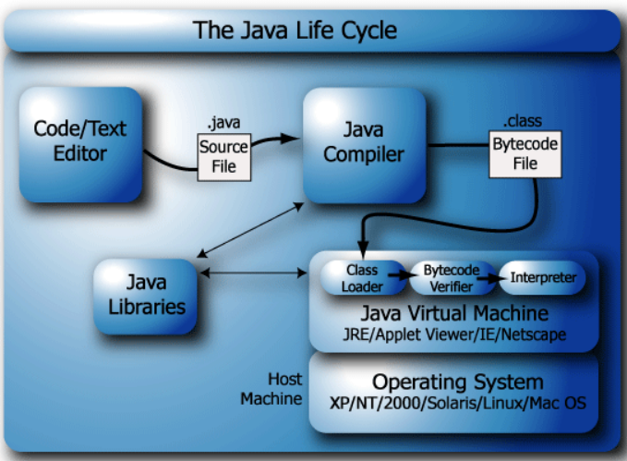
June 2019
Nalinadevi Kadiresan

Slide 9
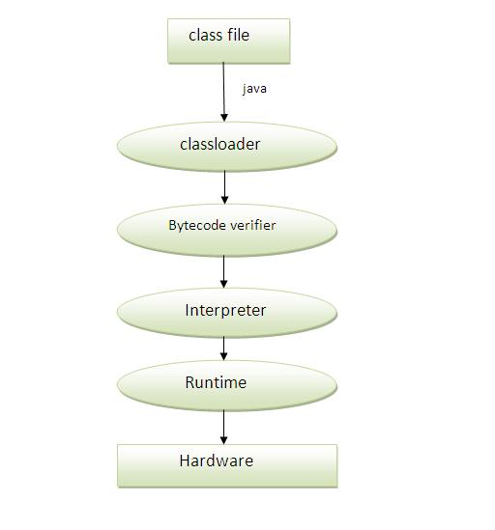
Java program at run time
Classloader: is the subsystem of JVM that is used to load class files.
Bytecode Verifier: checks the code fragments for illegal code that can violate access right to objects.
Interpreter: read bytecode stream then execute the instructions.
June 2019
Nalinadevi Kadiresan

Slide 10
Difference between JDK, JRE and JVM
Understanding the difference between JDK, JRE and JVM is important in Java.
  We are having brief overview of JVM here.
  Let's see the basic differences between the JDK, JRE and JVM.

Slide 11

JVM
JVM (Java Virtual Machine) is an abstract machine. It is a specification that provides runtime environment in which java bytecode can be executed.
JVMs are available for many hardware and software platforms. JVM, JRE and JDK are platform dependent because configuration of each OS differs. But, Java is platform independent.
The JVM performs following main tasks: Loads code Verifies code Executes code Provides runtime environment

Slide 12

JRE
JRE is an acronym for Java Runtime Environment .It is used to provide runtime environment. It is the implementation of JVM. It physically exists. It contains set of libraries + other files that JVM uses at runtime.

Slide 13

JDK
JDK is an acronym for Java Development Kit. It physically exists.
When you download JDK, JRE is also downloaded
It contains JRE + development tools.

Slide 14
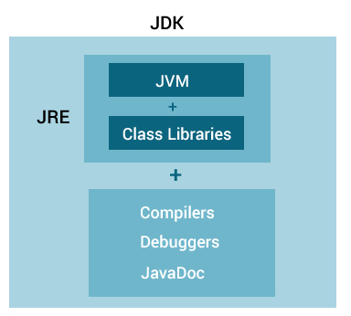
JVM, JRE, JDK relationship
June 2019
Nalinadevi Kadiresan

Slide 15
Java vs Python
Java | Python
Java is a compiled language | Python is a interpreted language
Java is a OO language | Python is a multi-paradigm language – OO and functional
Java is statically typed (Type checking at compile time) | Python is dynamically typed (Type checking at runtime)
Java implements concurrency with multithreading | Python implements concurrency at process level.
June 2019
Nalinadevi Kadiresan

Slide 16
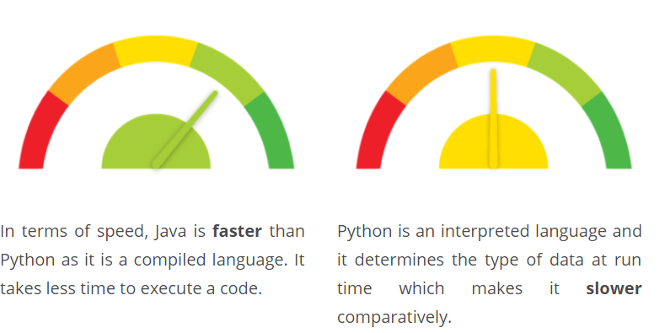
Java vs Python – Execution Speed
June 2019
Nalinadevi Kadiresan

Slide 17
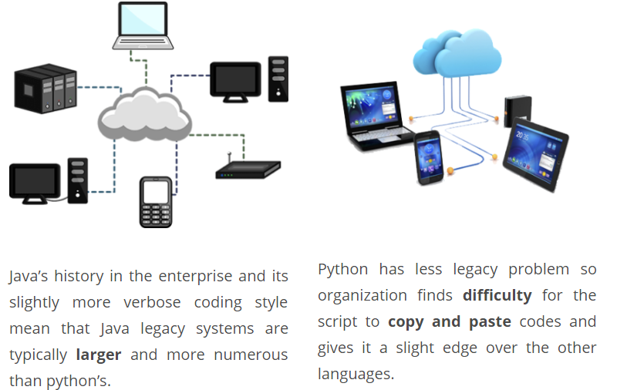
Java vs Python – Legacy system
June 2019
Nalinadevi Kadiresan

Slide 18
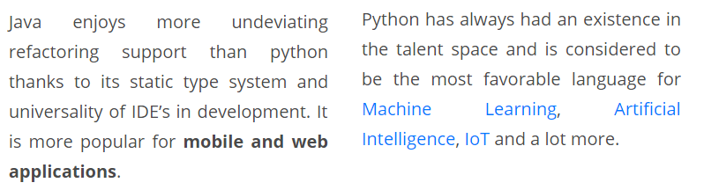
Java vs Python – practical agility
Refactoring is a controlled technique for improving the design of an existing code base.
  small, manageable steps that incrementally increase the cleanliness of code while still maintaining the functionality of the code
June 2019
Nalinadevi Kadiresan

Slide 19
Java vs Python
Choosing which language to goes with depends on your company’s needs, and which setbacks you’re willing to accept.
  While Java churns out higher performance speed, Python is more suited to evolve legacy systems.
  When it comes to practical agility, Java is a more proven option, while Python has more flexibility for experimentation.
June 2019
Nalinadevi Kadiresan

Slide 20
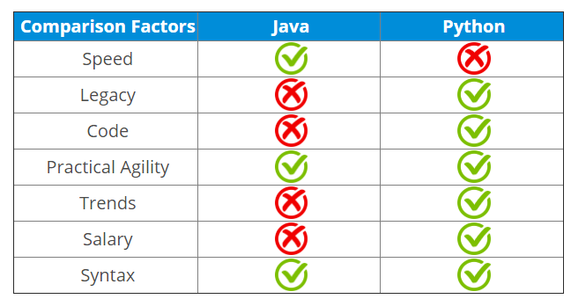
Java vs Python
Courtesy: https://stackify.com/java-vs-python/
https://www.edureka.co/blog/java-vs-python/
June 2019
Nalinadevi Kadiresan

Slide 21
Supplemental reading
Getting Started
http://java.sun.com/docs/books/tutorial/getStarted/index.html
Nuts and bolts of the Java Language
http://java.sun.com/docs/books/tutorial/java/nutsandbolts/index.html
Compiling and Running a Simple Program
http://developer.java.sun.com/developer/onlineTraining/Programming/BasicJava1/compile.html

Slide 22
Object Oriented Development
First Goal: Model the objects of the world
  Noun-oriented
  Focus on the domain of the program
Phases
  Object-Oriented Analysis: understand the domain
    Define an object-based model of it
  Object-Oriented Design: Define an implementation
    Design the solution
  Object-Oriented Programming: Build it
June 2019
Nalinadevi Kadiresan

Slide 23
Next Session will be
Object Oriented Analysis
June 2019
Nalinadevi Kadiresan

